Slide 1
Online Shopping Cart

Slide 2
OBJECTIVE:
Looking for an online shopping site to manage the items in the shop and also help customers purchase them online without having to visit the shop physically.
Internet shopping has become the fastest-growing use of the Internet; most Online consumers, however, use information gathered online to make purchases Off-line. A number of customers have attributed consumers' reluctance to purchase Online. Shopping from home allows you to shop at your own convenience – often 24 hours a day, seven days a week. There are no parking spaces so scout at the mall, no crowds to battle and no long lines. When you’re shopping from the comfort of home, you can order all kinds of products and services from companies in other States, even other countries. You can check the balance of your accounts and determine when an automatic deposit or withdrawal has taken place. But shopping from home, like traditional shopping, isn’t without risk.

Slide 3
The Online Store allows visitors to your on-line shopping site to collect items in a virtual shopping cart. They may view the contents of their shopping cart at any time and may add or delete items at will. The Online Store automatically calculates the subtotal, sales tax, shipping charges, and grand total. When a visitor decides to check-out, the order information including the buyer's name, address and billing instruction is e-mailed to your order department (or whomever you choose) and a receipt is sent to the shopper.

Slide 4
PURPOSE OF THE SYSTEM:
This system provides an online shopping site to manage the items in the shop and also help customers to purchase the items in online.

Slide 5
EXISTING SYSTEM:
This system is a manual system which doesn’t provide secure registration as well as profile management facilities customers
This system doesn’t provide online purchasing
This system can’t maintain most purchased items and least purchased items
Existing system can’t update the recent items for customers.

Slide 6
PROPOSED SYSTEM:
The development of this new system contains the following activities, which try to develop on-line application by keeping the entire process in the view of database integration approach.
Secure registration and profile management facilities for customers
Browsing through the email to see the items that are there in each category of products like apparel, kitchen accessories, bath accessories, food items etc.
Creating a shopping mart so that customer can Shop ‘n’ no of items and checkout finally with the entire shopping cart .

Slide 7
Customers should be able to mail the shop about the items they would like to see in the shop.
Secured mechanism for checking out from the shop.
Updates to customers about the recent items in the shop.
Uploading most purchased items in each category of products in the shop like apparel, kitchen accessories, bath accessories, food items etc

Slide 8
NO OF MODULES:
The system after careful analysis has been identified to be presented with the following
modules:
The Modules involved are
Customer
Employee
Admin
Security and authentication
Reports

Slide 9
CUSTOMER:
Customer searches the items by category wise, select the item and pay the bill. Customer takes online help from the administrator or employee. Customer check the status of the orders list.

Slide 10
EMPLOYEE:
Employees are responsible for internal affairs like processing orders, assure home delivery, getting customers delivery time feedback, updating order’s status and answering client queries online.

Slide 11
ADMINISTRATOR:
Strategic data and graphs for Administrators and shop owners about the items that are popular in each category and age group. It give special discounts to premier customer.

Slide 12
SECURITY AND AUTHENTICATION:
User registration
Login as user or administrator
Change password
Forgot password

Slide 13
REPORTS:
In this module the different actors can generate the different types of reports according to their access.

Slide 14
SOFTWARE REQUIREMENTS :
Operating System : Windows XP/2003 or Linux
User Interface : HTML, CSS
Client-side Scripting : JavaScript
Programming Language : Java
Web Applications : JDBC, Servlets, JSP
IDE/Workbench : My Eclipse
Database : Oracle 11g
Server Deployment : Tomcat 9.0

Slide 15
FEASIBILITY STUDY

Slide 16
TECHNICAL FEASIBILITY:
Evaluating the technical feasibility is the trickiest part of a feasibility study. This is because, at this point in time, not too many detailed design of the system, making it difficult to access issues like performance, costs on (on account of the kind of technology to be deployed) etc. A number of issues have to be considered while doing a technical analysis.
Understand the different technologies involved in the proposed system
Find out whether the organization currently possesses the required technologies
Operational Feasibility:
Proposed project is beneficial only if it can be turned into information systems that will meet the organizations operating requirements. Simply stated, this test of feasibility asks if the system will work when it is developed and installed. Are there major barriers to Implementation? Here are questions that will help test the operational feasibility of a project:Is there sufficient support for the project from management from users? If the current system is well liked and used to the extent that persons will not be able to see reasons for change, there may be resistance.

Slide 17
Economic Feasibility:
Economic feasibility attempts 2 weigh the costs of developing and implementing a new system, against the benefits that would accrue from having the new system in place. This feasibility study gives the top management the economic justification for the new system.

Slide 18
DATA FLOW DIAGRAMS

Slide 19
A graphical tool used to describe and analyze the moment of data through a system manual or automated including the process, stores of data, and delays in the system. Data Flow Diagrams are the central tool and the basis from which other components are developed. The transformation of data from input to output, through processes, may be described logically and independently of the physical components associated with the system. The DFD is also know as a data flow graph or a bubble chart.
Dataflow: Data move in a specific direction from an origin to a destination.
Process: People, procedures, or devices that use or produce (Transform) Data. The physical component is not identified.
Source: External sources or destination of data, which may be People, programs, organizations or other entities.
Data Store: Here data are stored or referenced by a process in the System.

Slide 20
Context Level Data Flow Diagram

Slide 21
AUTHENTICATION DFD:

Slide 22
Administrator:

Slide 23
Level-1 Data Flow Diagram for Admin:

Slide 24
LEVEL-2 DIAGRAM:
ADMINISTRATOR:

Slide 25
LEVEl-3:
Administrator:

Slide 26
Customer:

Slide 27
Leve-1 Data Flow Diagram for Customer:

Slide 28
LEVEL-2 Data Flow Diagram for Customer:

Slide 29
LEVEL-3 Data Flow Diagram for Customer

Slide 30
LEVEL-4
Customer:
Level 4 Data Flow Diagram for Add New Item Details
Level 4 Data Flow Diagram for Add New Brand Details

Slide 31
Employee Context Level Data Flow Diagram:

Slide 32
Level-1 Data Flow Diagram for Employee:

Slide 33
LEVEL-2 Data Flow Diagram for Employee:

Slide 34
Level -3 Data Flow Diagram for Employee:

Slide 35
SDLC METHODOLOGIES

Slide 36
This document play a vital role in the development of life cycle (SDLC) as it describes the complete requirement of the system. It means for use by developers and will be the basic during testing phase. Any changes made to the requirements in the future will have to go through formal change approval process.
SPIRAL MODEL was defined by Barry Boehm in his 1988 article, “A spiral Model of Software Development and Enhancement. This model was not the first model to discuss iterative development, but it was the first model to explain why the iteration models.
The steps for Spiral Model can be generalized as follows:
The new system requirements are defined in as much details as possible. This usually involves interviewing a number of users representing all the external or internal users and other aspects of the existing system.
A preliminary design is created for the new system.
A first prototype of the new system is constructed from the preliminary design. This is usually a scaled-down system, and represents an approximation of the characteristics of the final product.

Slide 37
A second prototype is evolved by a fourfold procedure:
Evaluating the first prototype in terms of its strengths, weakness, and risks.
Defining the requirements of the second prototype.
Planning an designing the second prototype.
Constructing and testing the second prototype.
Risk factors might involved development cost overruns, operating-cost miscalculation, or any other factor that could, in the customer’s judgment, result in a less-than-satisfactory final product.
The existing prototype is evaluated in the same manner as was the previous prototype, and if necessary, another prototype is developed from it according to the fourfold procedure outlined above.
The preceding steps are iterated until the customer is satisfied that the refined prototype represents the final product desired.
The final system is constructed, based on the refined prototype.
The final system is thoroughly evaluated and tested. Routine maintenance is carried on a continuing basis to prevent large scale failures and to minimize down time.

Slide 38
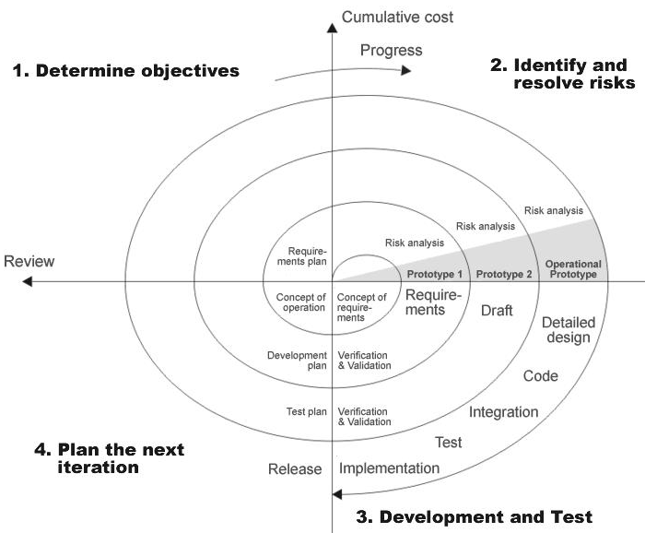
THE FOLLOWING DIAGRAM SHOWS HOW A SPIRAL MODEL ACTS LIKE:

Slide 39
ADVANTAGES OF SPIRAL MODEL:
High amount of risk analysis hence, avoidance of risk enhanced.
Good for large and mission critical projects.
Strong approval and documentation control.
Additional functionality can be added at a later date.
S/w is produced early in the S/W life cycle.
DISVANTAGE OF SPIRAL MODEL:
Can be a costly model to use.
Doesn’t work well for smaller projects.
It is not suitable for low risk projects.

Slide 40
UML

Slide 41
The Unified Modeling Language allows the software engineer to express an analysis model using the modeling notation that is governed by a set of syntactic semantic and pragmatic rules.
A UML system is represented using five different views that describe the system from distinctly different perspective. Each view is defined by a set of diagram, which is as follows.
User Model View.
Structural Model View.
Behavioral Model View.
Implement Model View.
Environmental Model View.
UML is specifically constructed through two different domains they are:
UML Analysis modeling, this focuses on the user model and structural model views of the system.
UML design modeling, which focuses on the behavioral modeling, implementation modeling and environmental model views.

Slide 42
USE CASE DIAGRAMS

Slide 43
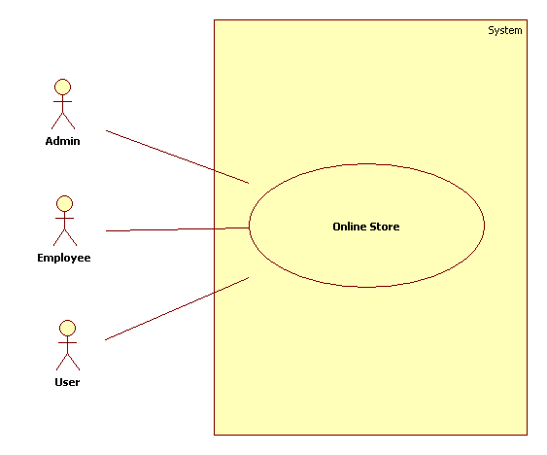
System Use Case Diagram:

Slide 44
Administrator Use Case Diagram:
Item
Products
Categery
Inventory
View Categery
Add Employe
Employees
View Employe
Admin
Queries
View Queries
Orders
View Orders

Slide 45
Customer Use Case Diagram:

Slide 46
Employee Use Case Diagram

Slide 47
COLLABORATION DIAGRAM

Slide 48
Admin collaboration Diagram:

Slide 49
Employee Collaboration Diagram:

Slide 50
Customer Collaboration Diagram:

Slide 51
OUTPUT SCREENS

Slide 52
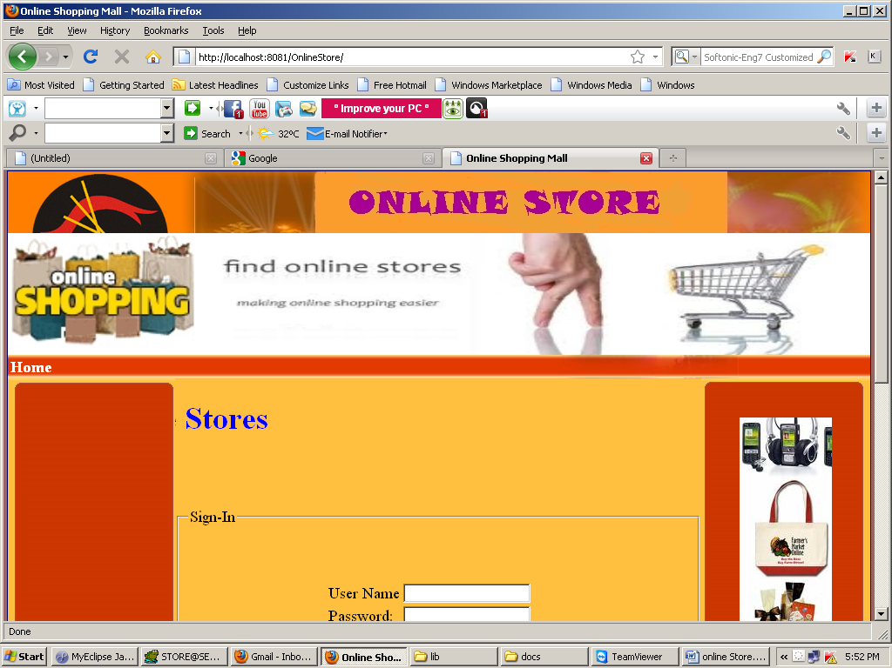
HOME PAGE

Slide 53
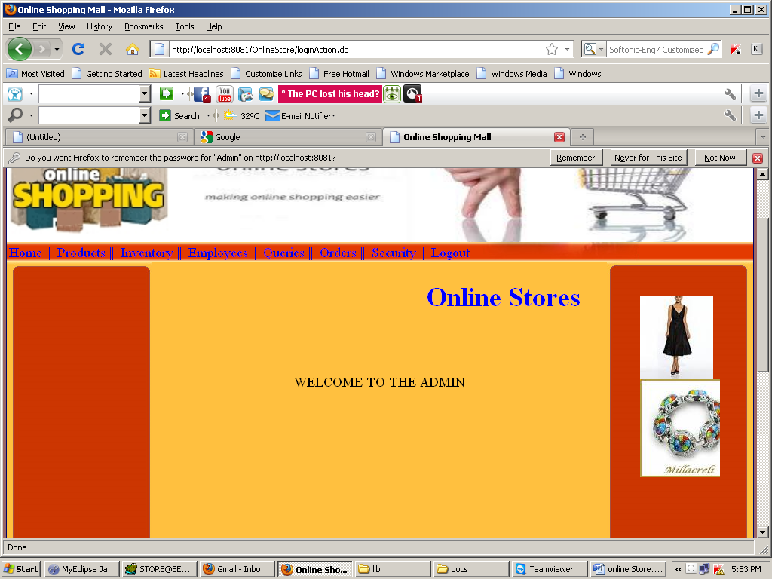
ADMIN HOME PAGE

Slide 54
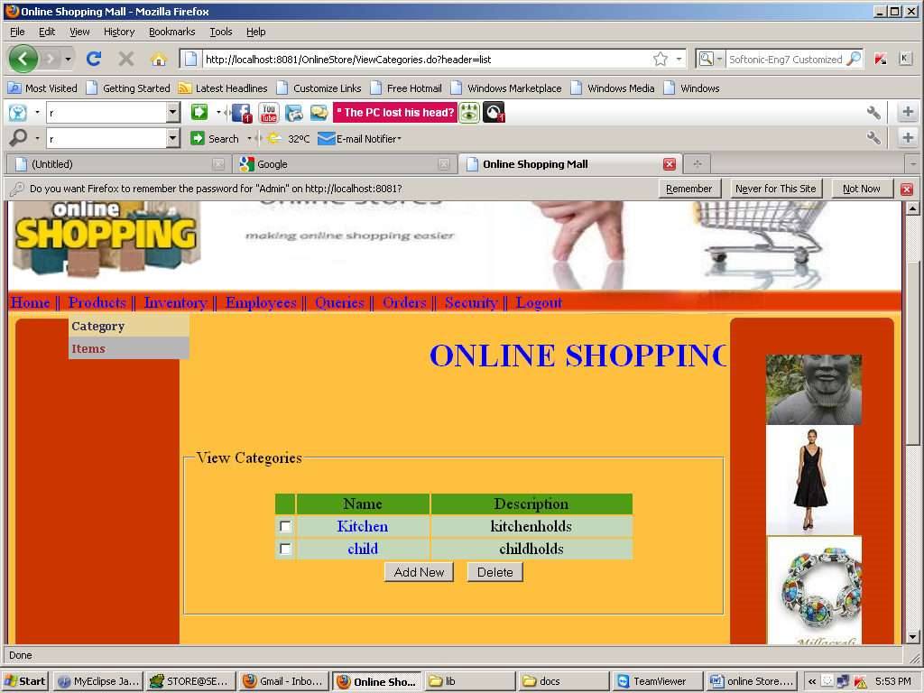
VIEW CATEGORIES

Slide 55
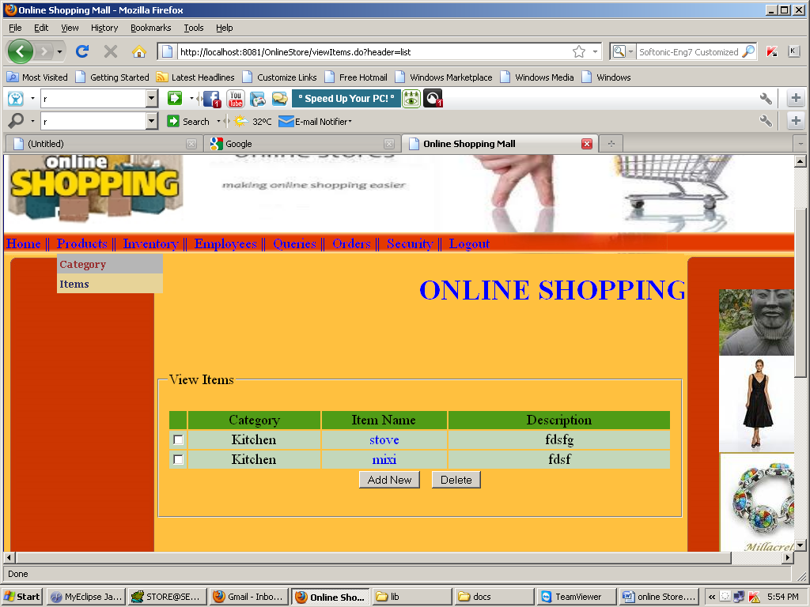
VIEW ITEMS

Slide 56
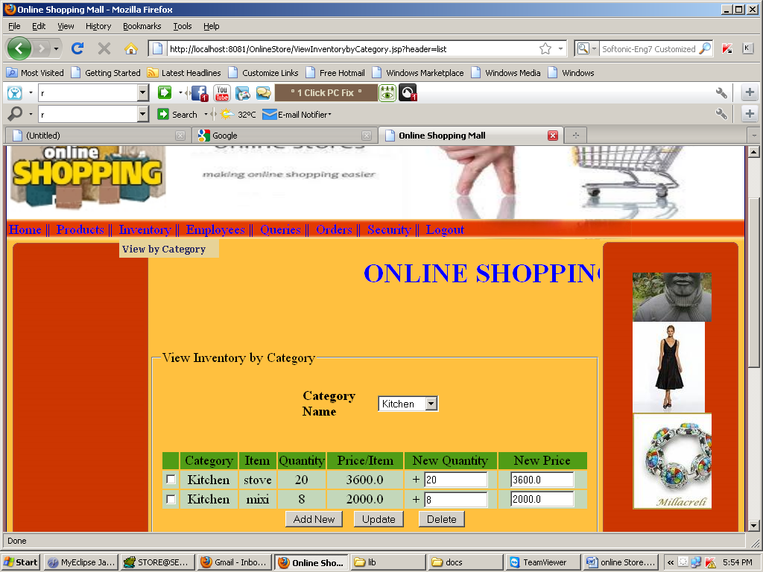
VIEW INVENTORY BY CATEGORY

Slide 57
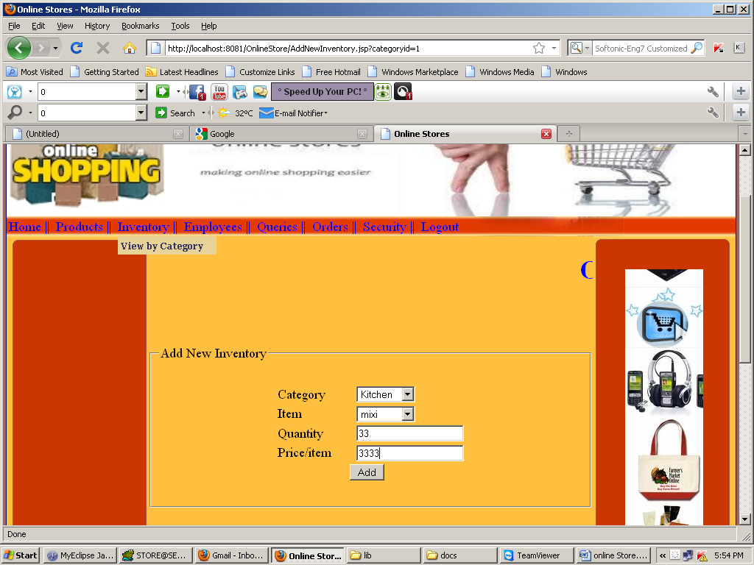
ADD NEW INVENTORY

Slide 58
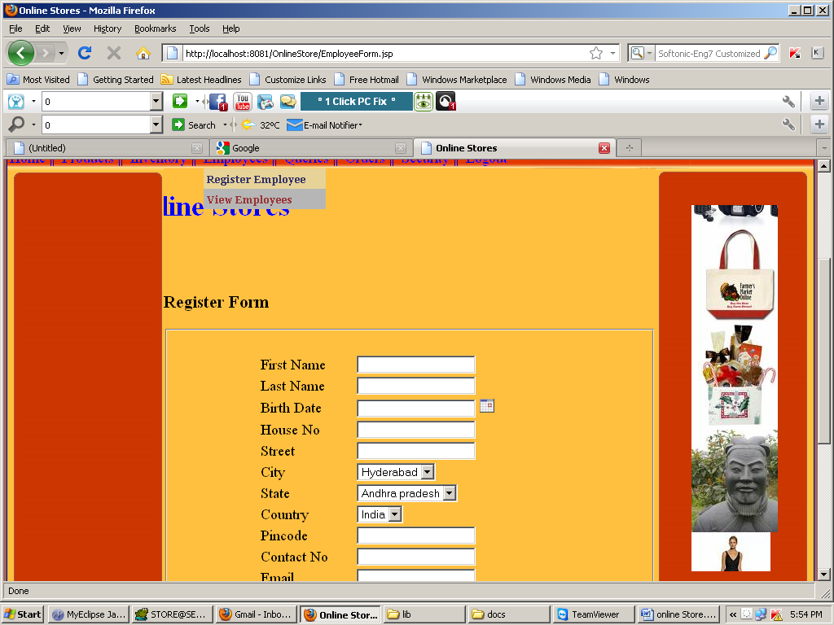
NEW REGISTRATION FROM

Slide 59
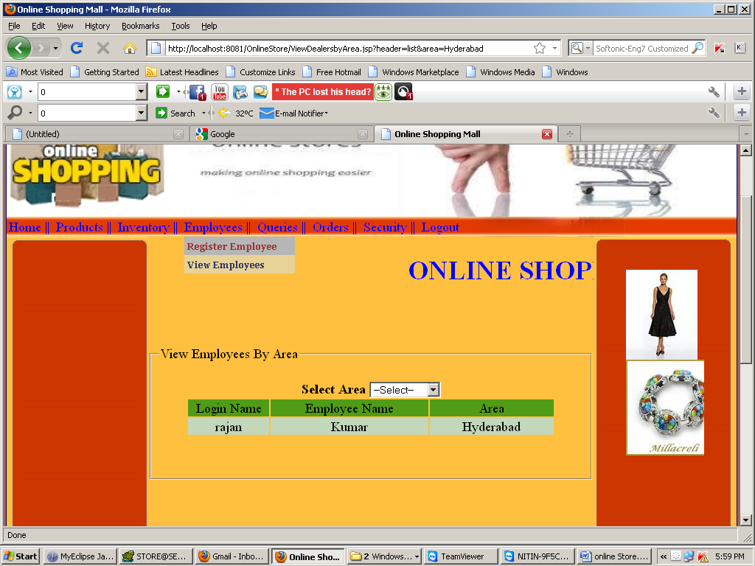
VIEW EMPLOYEES BY AREA

Slide 60
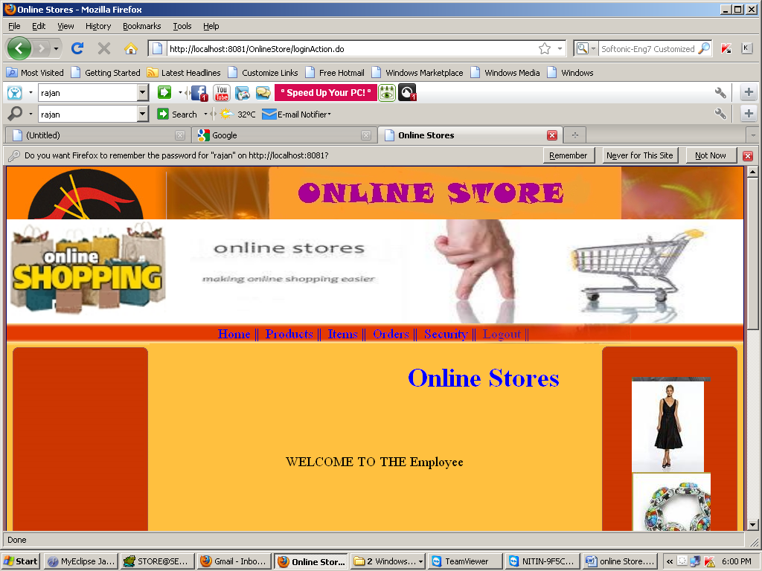
EMPLOYEES HOME PAGE

Slide 61
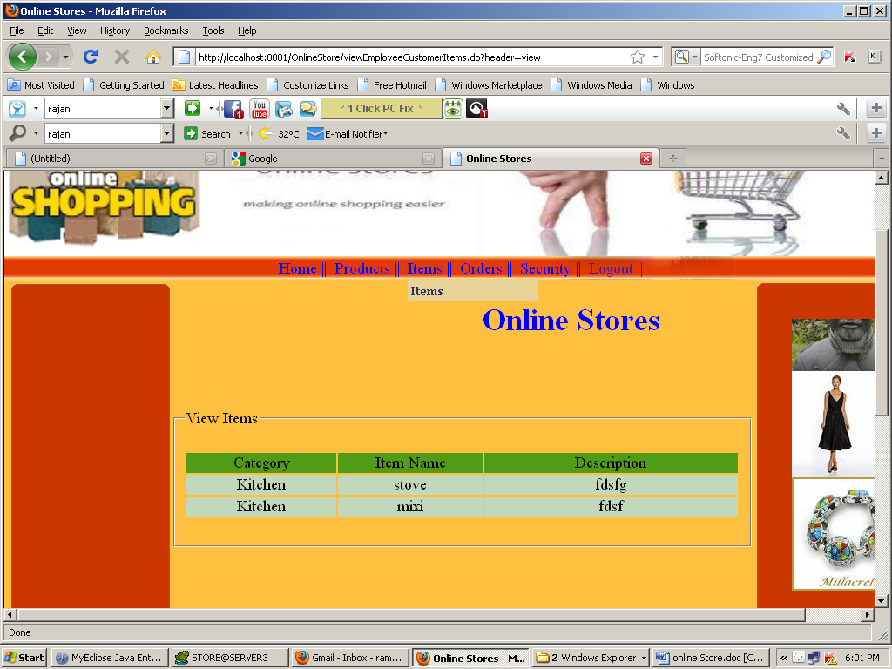
VIEW ITEMS

Slide 62
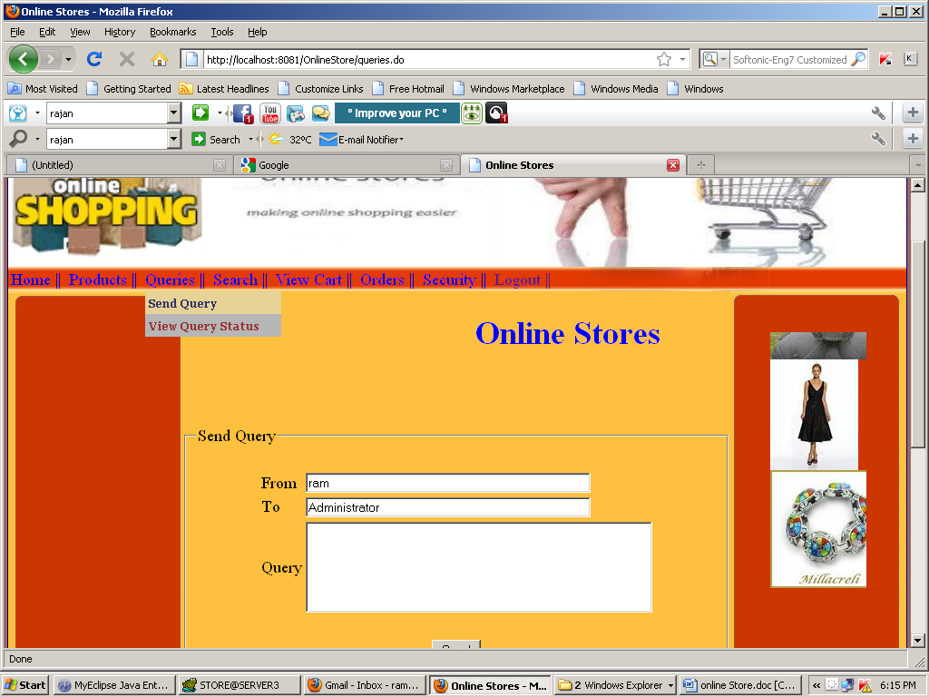
SEND QUERY

Slide 63
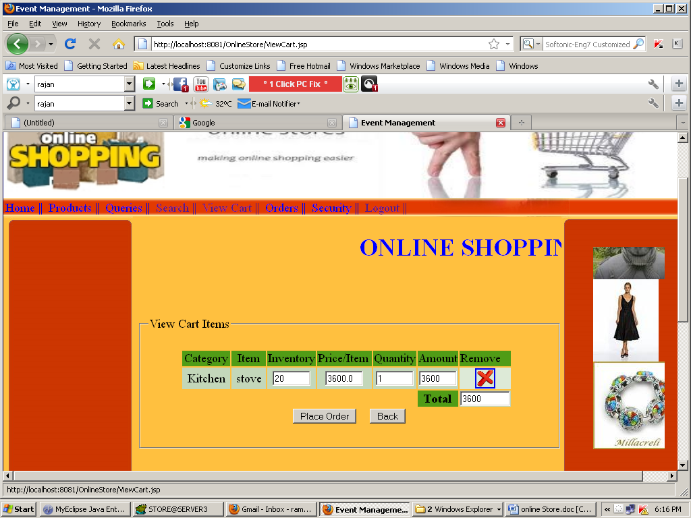
VIEW CART ITEMS

Slide 64
THANK YOU

